Slide 1
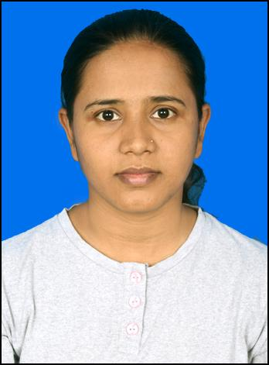
Khushboo Chaurasiya| Sr. Software Engineer
Technical and Functional Skills
Professional Experience
C#,.Net Core,Asp.net,.net Core MVC,Web API, Entity framework, Angular, MS SQL
Visual Studio and Versioning tools like SVN, GIT, and TFS.
Data Modelling, User Stories, Wireframing.
Involved in Requirement Gathering, Handled a Change Request and worked on user stories.
SQL profiler, Stored procedures.
Draw.io, Figma, Sequencediagram.org​
4+ years of professional experience in Software Analysis, Design and Development for web-based applications using .net technologies.
Gained experience in Designing data model, Hands-on in Web API in different layers, server-side validations, MVC and Had an experience in Angular.
Gained some knowledge on CQRS pattern, Repositry Pattern and Dependency Injection.
Solid understanding of software development life cycle processes including requirements gathering, analysis and design, development tools and technologies, release and version control.
Also worked with Entity Framework Core 6 and performed unit-testing with Xunit & Moq framework.​

